Slide 1


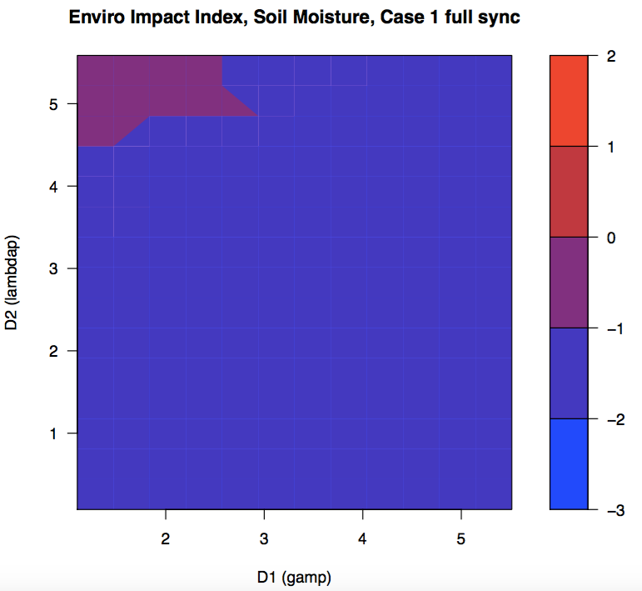
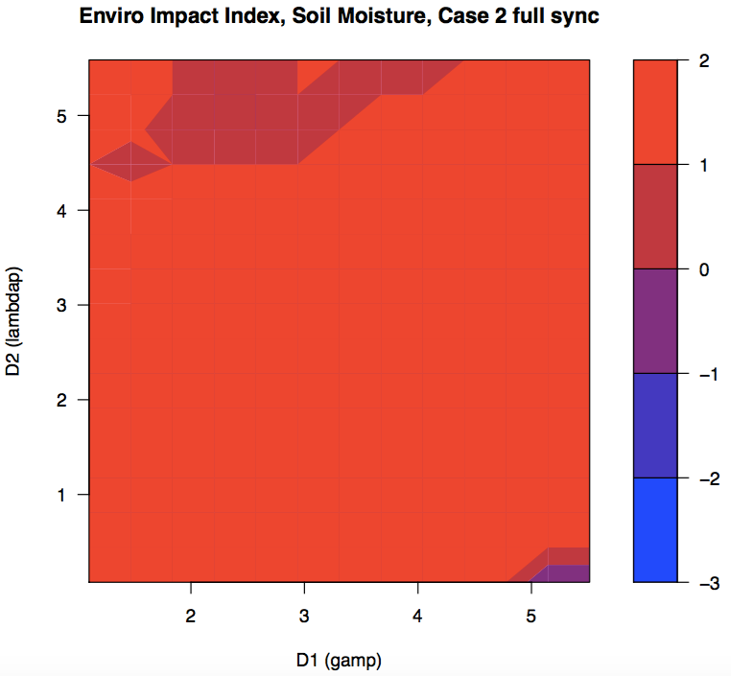
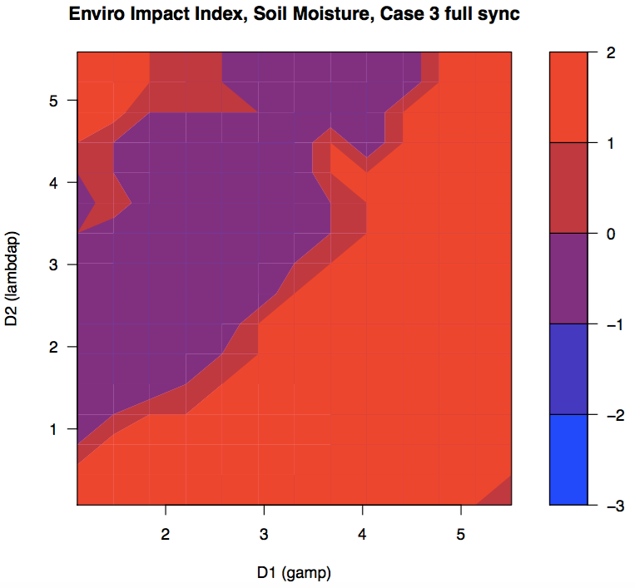
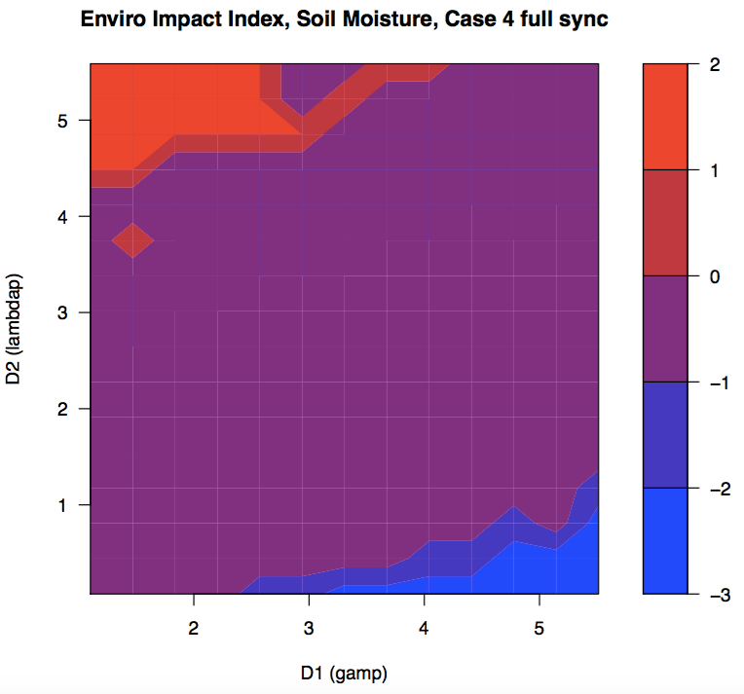
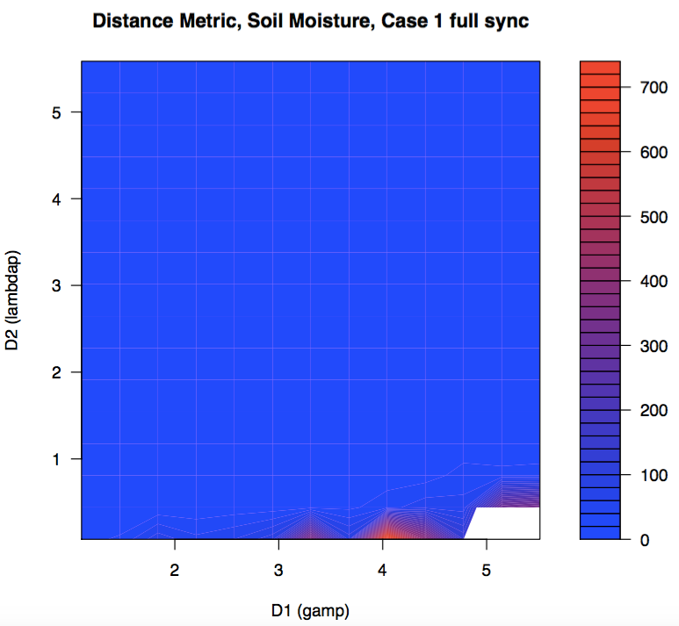
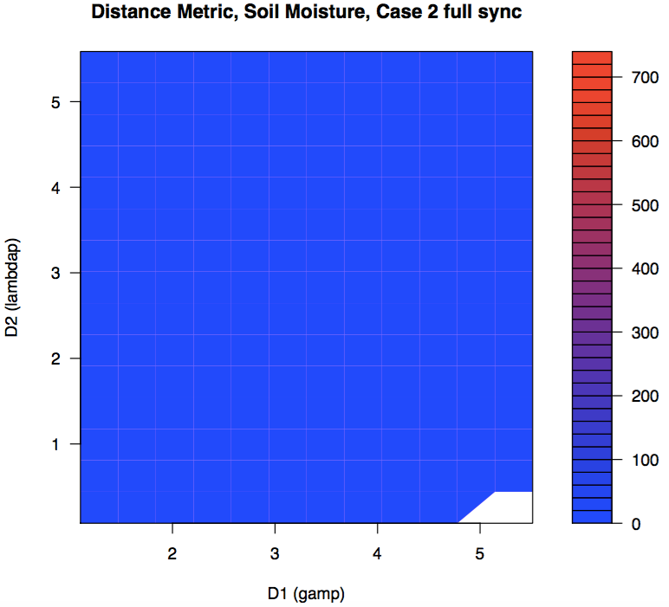
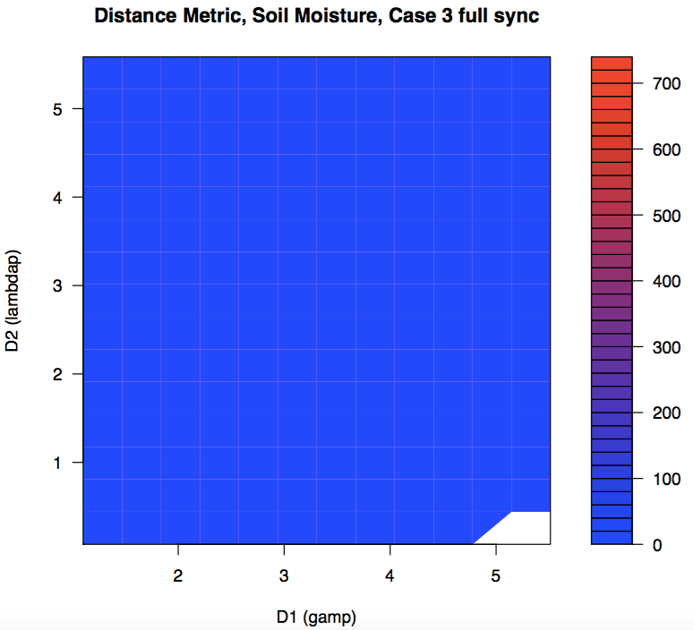
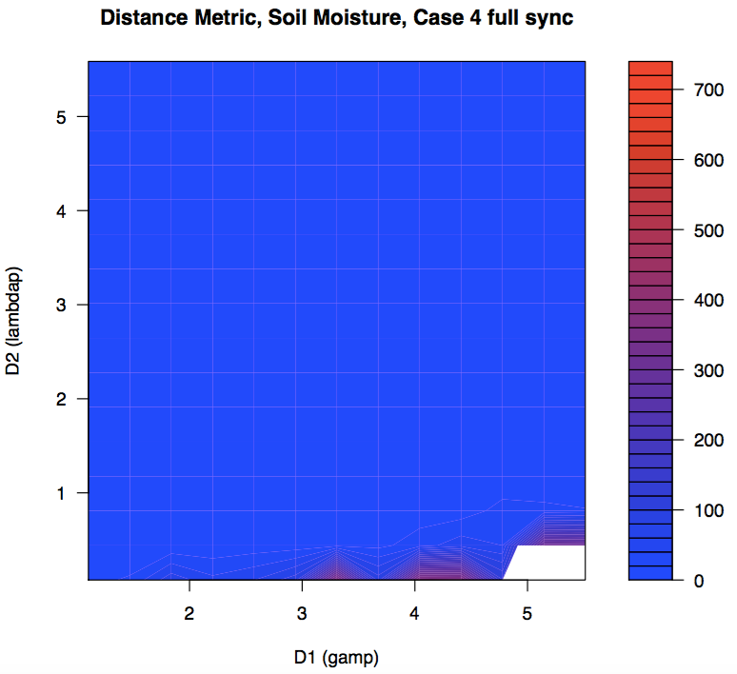
Feasibility and Sustainability of Irrigation Practices
Minghui Zhang; Sally Thompson, PhD
University of California, Berkeley
Motivation
Irrigation and Streamflow Dynamics
Environmental Implications
Incorporating anthropogenic activity into “predictions in ungauged basins” (PUB) efforts is essential given the high level of development of many basins.
We explored the effects of irrigation on streamflow dynamics and environmental sustainability.
Our work supports PUB efforts in heavily irrigated, but sparsely gauged, basins.
Research Questions
How does a given irrigation strategy affect streamflow for a variety of catchment types?
How heavily does irrigation impact water supply sustainability?
A weighted sum describing each irrigation technique’s impact on groundwater storage, streamflow volume, and feasibility of agriculture in the area form an environmental and social impact metric. (Srinivasan et al., 2011)
Periodic irrigation causes “saw-tooth” pattern
Model
We modified the Botter et al 2007 soil moisture model to account for four irrigation sources.
Circle areas of note
Three areas of the contour plots below represent exception cases, and should not be considered:
Irrigation is needed, but less than 50% of the need is met
Irrigation is unnecessary. Natural conditions support agriculture
Distance metric cannot be calculated because streamflow never peaks
Replace words with the legend
Irrigation is triggered at 60% of field capacity.
Distance metric
Add disc sentence for enviro impact
Monte Carlo results for an arid catchment (Budyko aridity index = 2.5) are below. Streamflow is described with average streamflow, average peak height, and average peak frequency.
Summary
Circle areas of note
We used a simple lumped model to produce reasonable estimations of streamflow behavior in response to irrigation.
Streamflow metrics (α, λ, average streamflow) and an environmental impact metric describe changes in the catchment attributed to irrigation.
Our results provide a first insight into PUB methodologies that could be employed in heavily managed basins.
Future Work
We will expand our investigation to other irrigation strategies (including fixed scheduling and the crop coefficient method) and look for unique fingerprints of each irrigation strategy on streamflow metrics.
Our predictions will be validated in basins for which irrigation and streamflow are known.
We will then use statistical techniques to compute the likelihood of each irrigation practice in a set of potential irrigation scenarios using streamflow data alone.
A distance metric describes the magnitude of streamflow change attributable to irrigation:
Irrigation is feasible outside of the exception cases. These areas generally experience minimal change in streamflow while providing adequate irrigation.
Deviations from natural streamflow in irrigated basins can be “fingerprinted” using changes in α, λ, and average streamflow.
Contact
References
Minghui Zhang
University of California, Berkeley
Email: minghuiz@berkeley.edu
Phone: (510) 883 4186
Botter, G; Porporato, A; Rodriguez-Iturbe, I; Rinaldo, A. “Basin-scale soil moisture dynamics and the probabilistic characterization of carrier hydrologic flows: Slow, leaching-prone components of the hydrologic response”. Water Resources Research, 43, 2007.
Porporato, Amilcare; Daly, Edoardo; and Rodriguez-Iturbe, Ignacio. “Soil water balance and ecosystem response to climate change”. The American Naturalist, 164:5, 2004.
Srinivasan, V; Lambin, EF; Gorelick, SM; Thompson, BH; and Rozelle, S. “The nature and causes of the global water crisis: Syndromes from a meta-analysis of coupled human-water studies”. Water Resources Research, 48: 2011.

